Slide 1
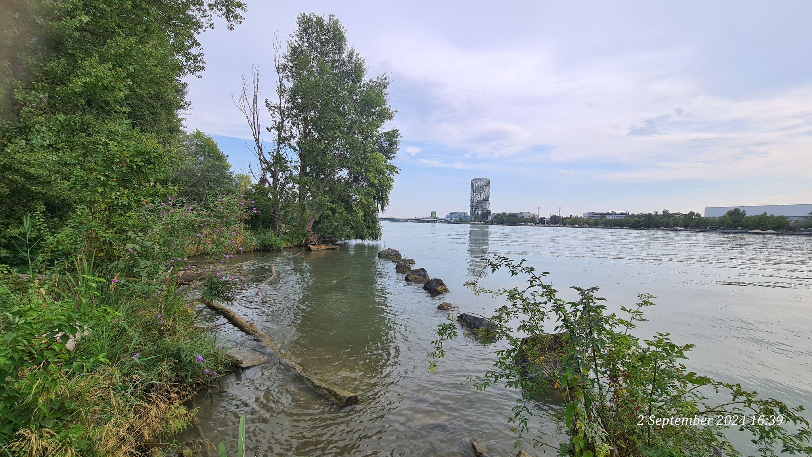
Perception
of pollution levels through music
Copyright: Jean Beers 2024
Univ.–Prof. Dr. Jean Beers
Artistic Researcher, Pianist, Composer, Professor

Slide 2
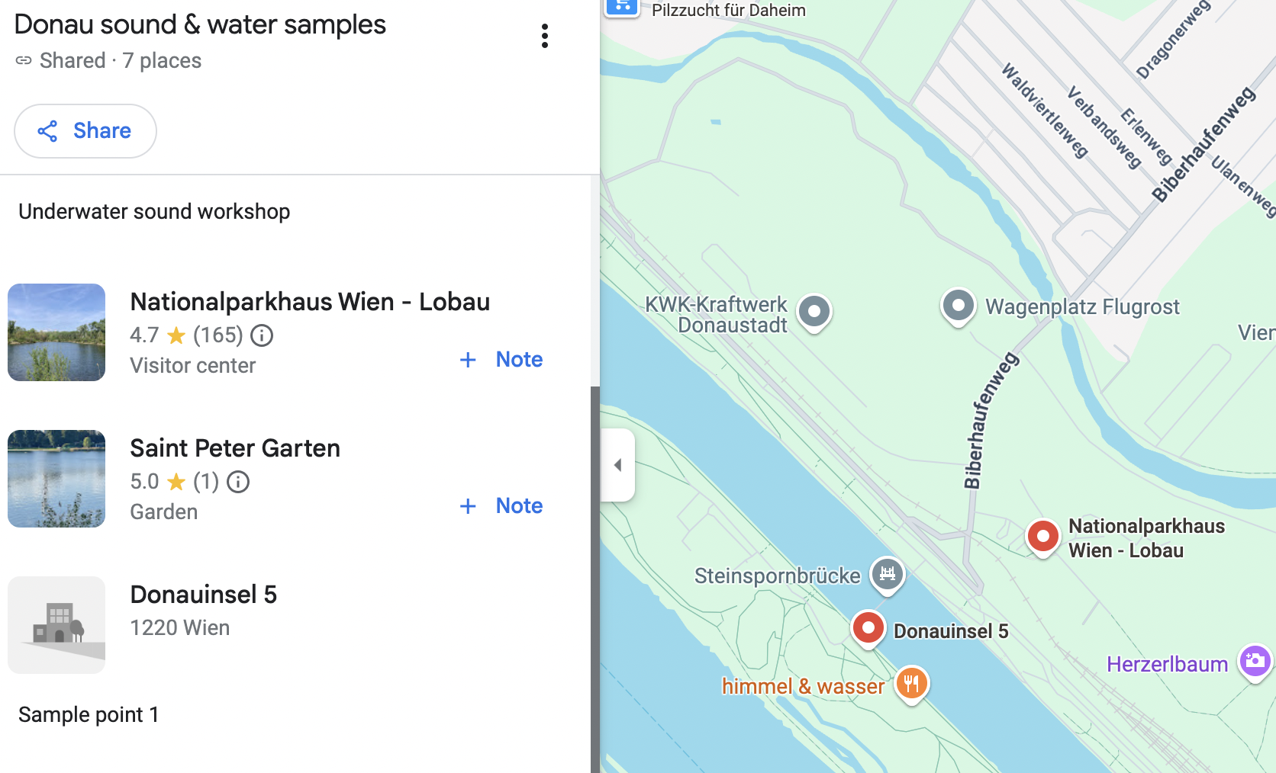
Collaboration with water scientist Vilmaurora Castillo (SRH Hochschule Heidelberg) and sound archiving researcher and artist Fernando Palacios Mateos (Polytechnic University of Valencia, Fine Arts Faculty).
My role: Artistic research collaborator for map-points in Vienna, creating artistic responses to soundscapes and raw audio recordings by Fernando Palacios Mateos and to water results by Vilmaurora Castillo.
My research: Exploring perception of pollution levels through musical interpretation through the medium of musical improvisation (solo piano and with my student ensemble) and through musical composition (electronic tape composition). Samples collected: Aug. 2024, musical responses: Oct.-Dec. 2024
Publication: Website with Interactive sound files on a map (Dec. ‘24)
Copyright: Jean Beers 2024
perception
River Danube water project June - December 2024
SRH Hochschule Heidelberg / Polytechnic University of Valencia / Music and Arts University of the City of Vienna (MUK)
Map points suggested by local guides Jean Beers and Stefan Schmidl (MUK) and defined collaboratively
https://protection.retarus.com/v1?u=https%3A%2F%2Fpadlet.com%2FWaterTechnologySOEA%2Fstream-t8sko3eqdym7pdk8&c=3s0vM6k&r=BhoPm3OJNhSCdokuhCEvQ&k=7s1&s=Hg1c7kSGDsTBqASMolGziYbVhvv0CnHsPEg3iw99hgr

Slide 3
Methodology
Copyright: Jean Beers 2024
Creative responses to natural surroundings in order to identify if pollution levels can be “heard” or sensed
Group improvisation (student ensemble)
Composition (electronic tape)
In my classes, I used raw audio data and soundscapes to improvise with my laptop, giving the students a sound basis and inspiration for their live group improvisations over it. We then performed one such improvisation in concert.
Group improvisation
(external ensemble)
I created an electronic composition (tape) as a collage of raw audio data that I recorded on the afternoon after meeting riverside with Vilma and Fernando. The composition reflects our discussions and my perception of the sound world I perceived while spending 4 hours sitting at the riverside, hiding my recording device in several places under greenery close the the water.
Real Ad Lib Mission (ReALM) Ensemble was founded by Jean Beers together with the most involved students and graduates from her student ensembles at MUK. ReALM is in demand on concert stages around Austria and known for innovative concert formats, stylistically free improvisation and contemporary music.
In our September concerts at MuTH Konzertsaal (Vienna), we performed a live improvisation for piano, inside piano, accordion and voice together with and inspired by the electronic audio collage composition by Jean Beers Hearing Inside Nature (2024).
Improvisation
(solo piano) – not done yet
Using 3 “masters” of soundscapes created by Fernando, I improvised 3 different solo sets, completely spontaneously in order to achieve a truly intuitive response to my perception of the sound.
Field recordings (Jean)
I recorded additional audios for inspiration and to use in the electronic composition.

Slide 4
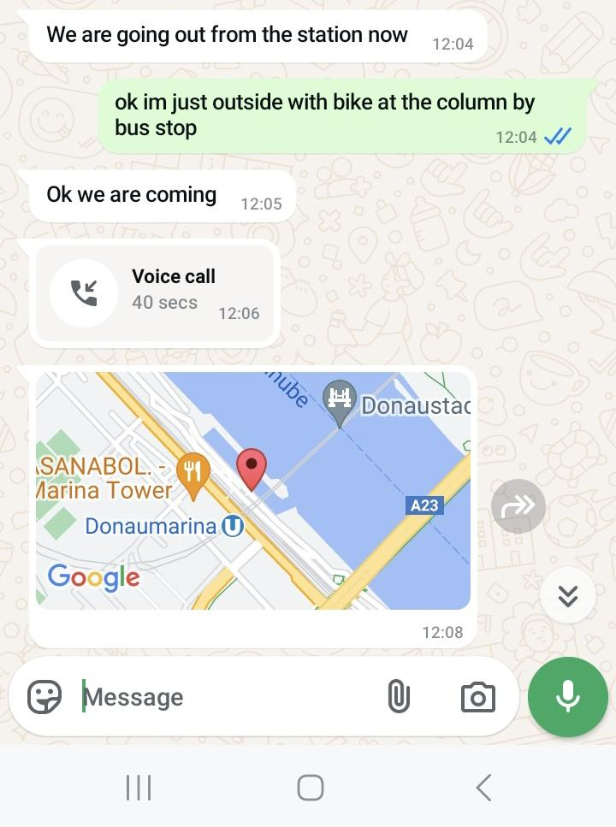
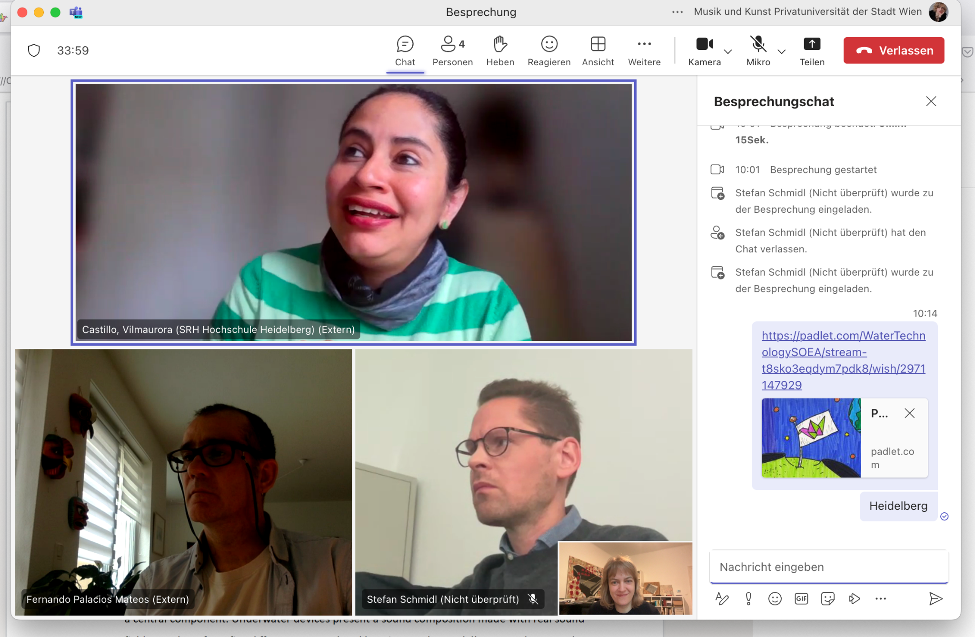
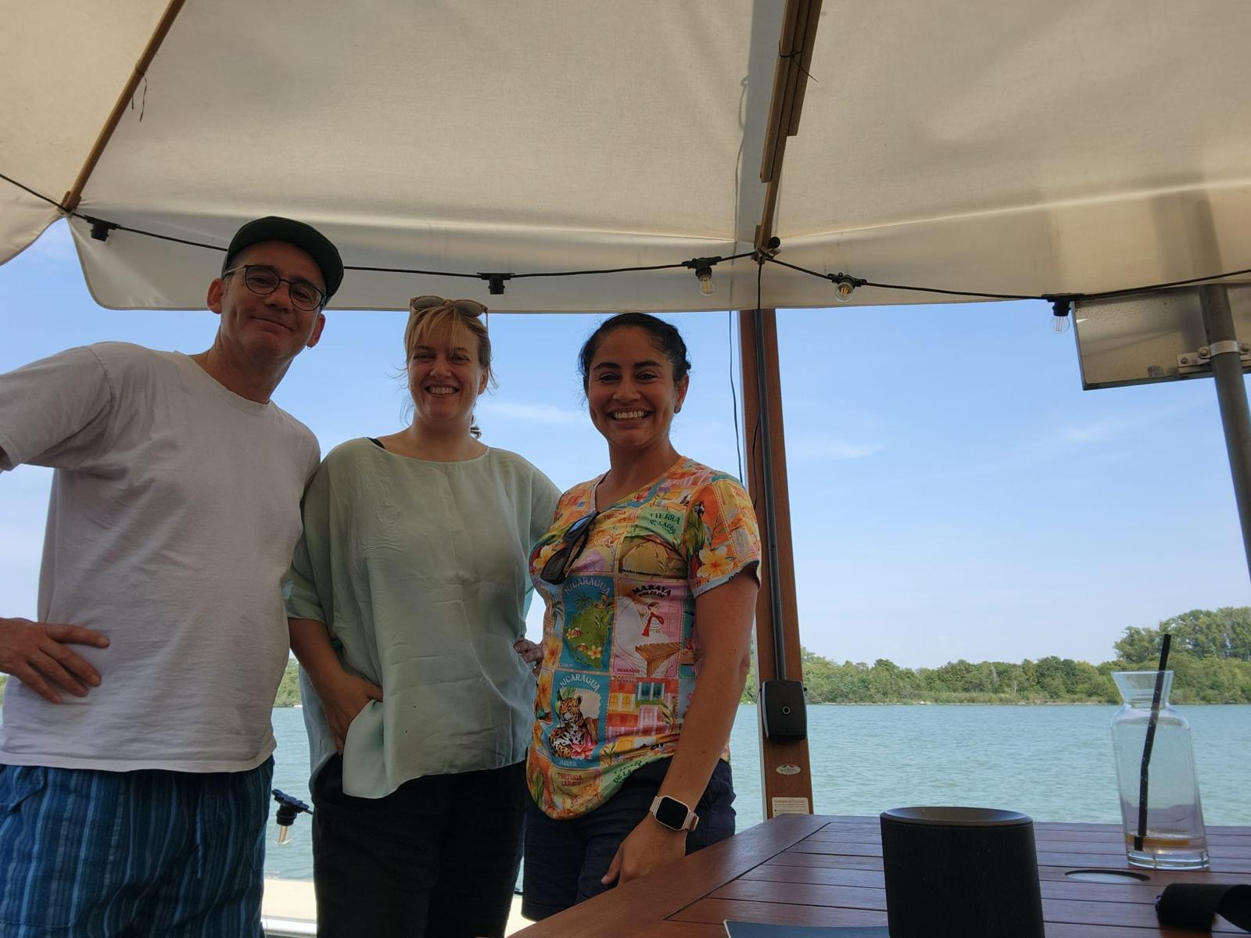
Meetings
Copyright: Jean Beers 2024
2 September field recordings
14:00-18:00
Jean Beers
Zoom / in person riverside
3 May Zoom meeting
11:00-12:30
15 July Zoom meeting
10:30-11:30
2 September
in person riverside meeting
12:10-14:00
Vilmaurora Castillo (SRH Heidelberg),
Fernando Palacios Mateos (Polytechnic University Valencia),
Jean Beers & Stefan Schmidl (MUK Vienna),
Vilmaurora Castillo,
Fernando Palacios Mateos,
Jean Beers
15 July Whatsapp audio call
11:00-12:00
Vilmaurora Castillo,
Jean Beers

Slide 5
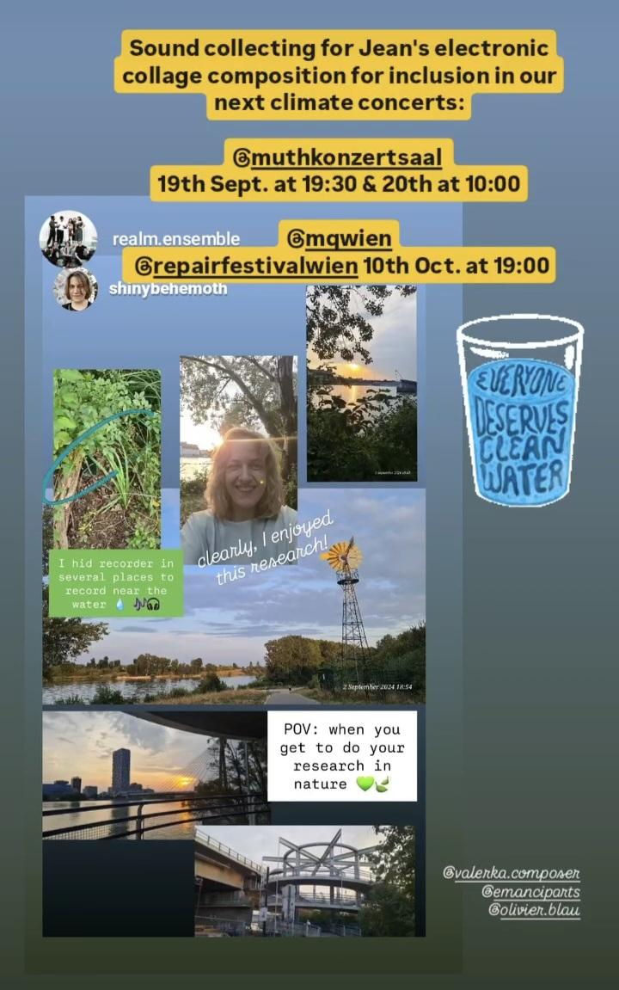
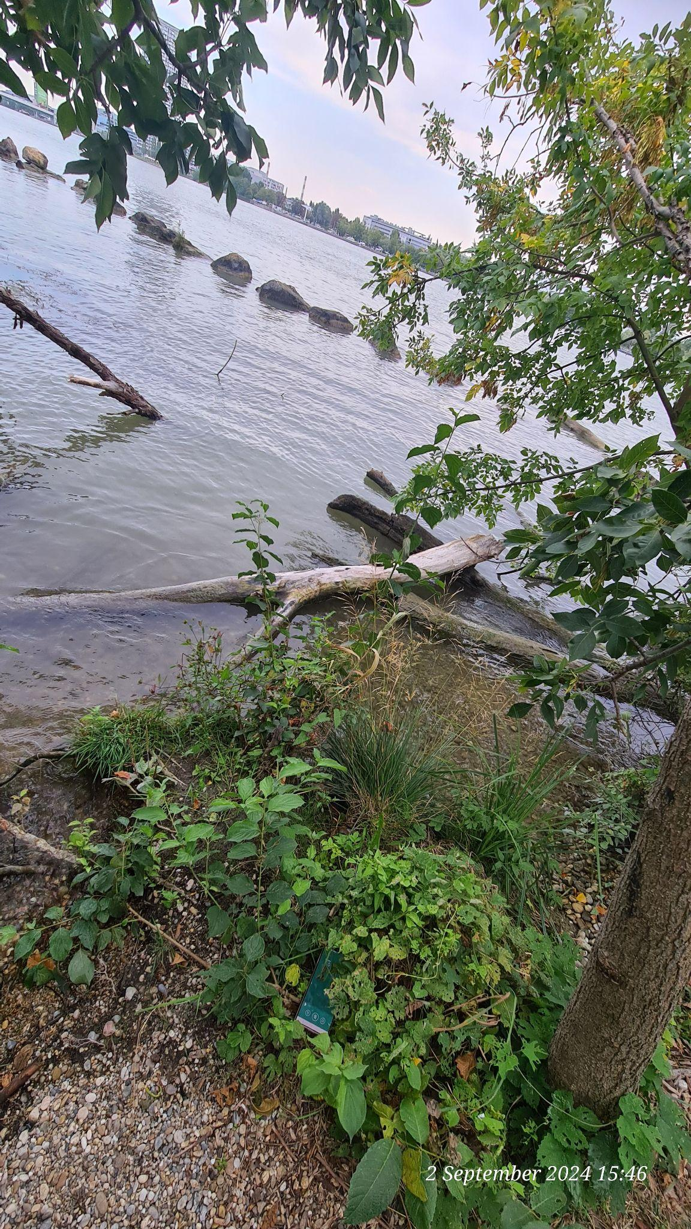
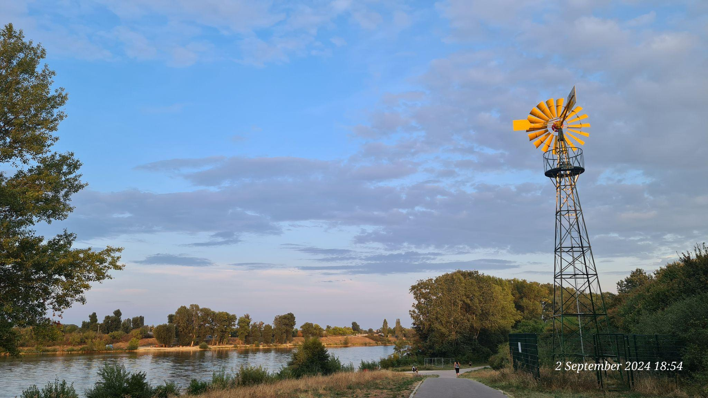
Field recordings (Jean)
Copyright: Jean Beers 2024
2 September 2024, 14:00-18:00
Location search
Hiding recorder in greenery
Social media documentation
Location-place polluted:
skin rash after swimming
Audible pollution? Audio data reveals ship traffic

Slide 6
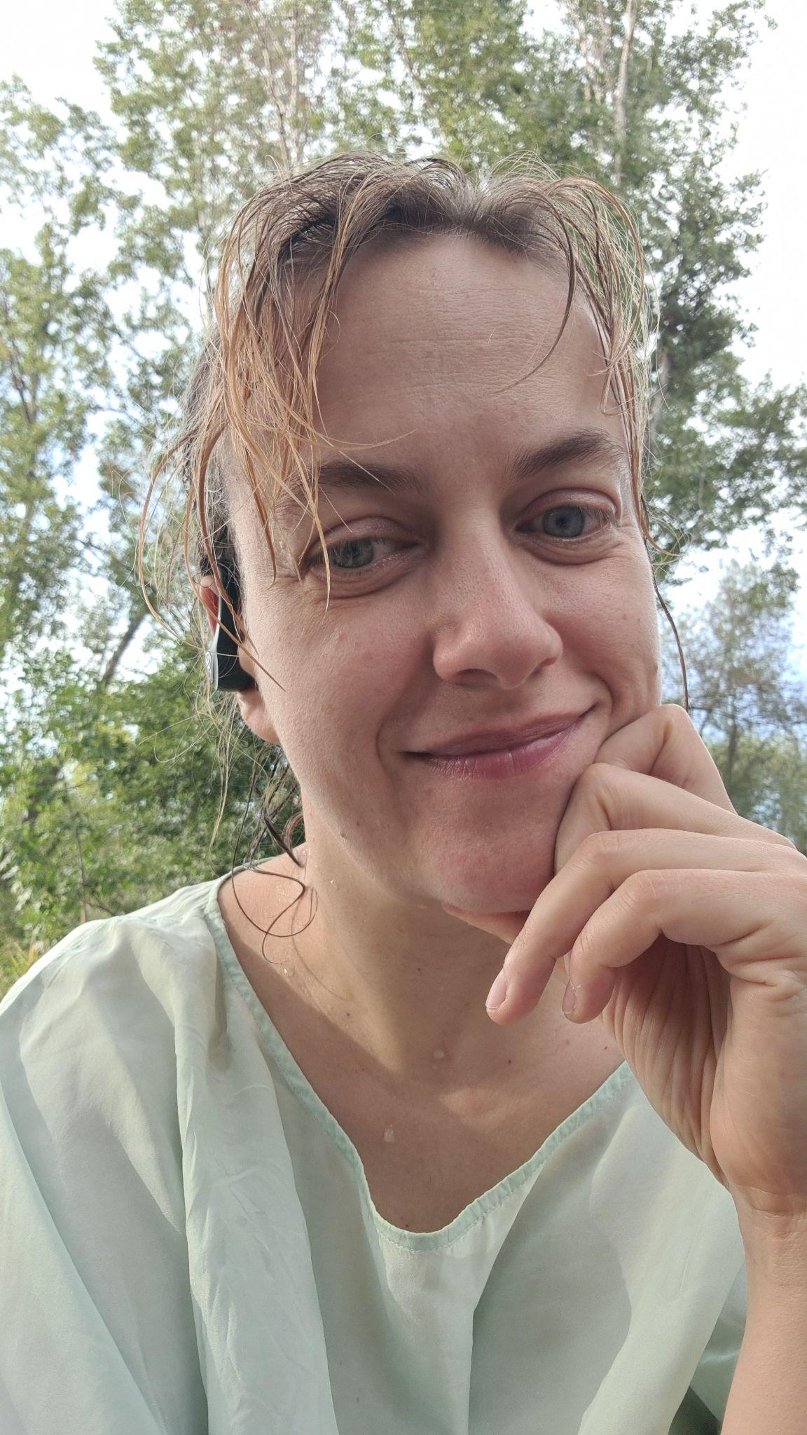
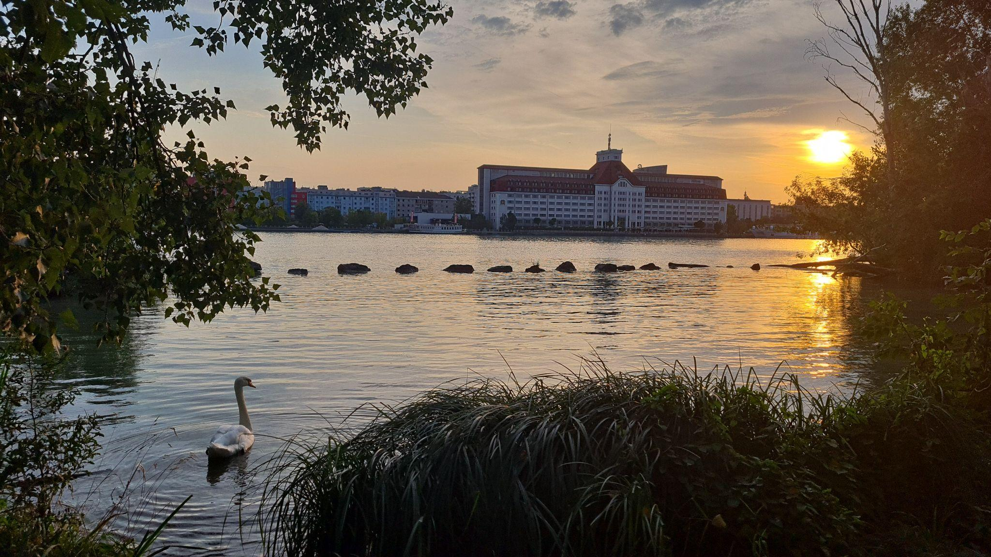
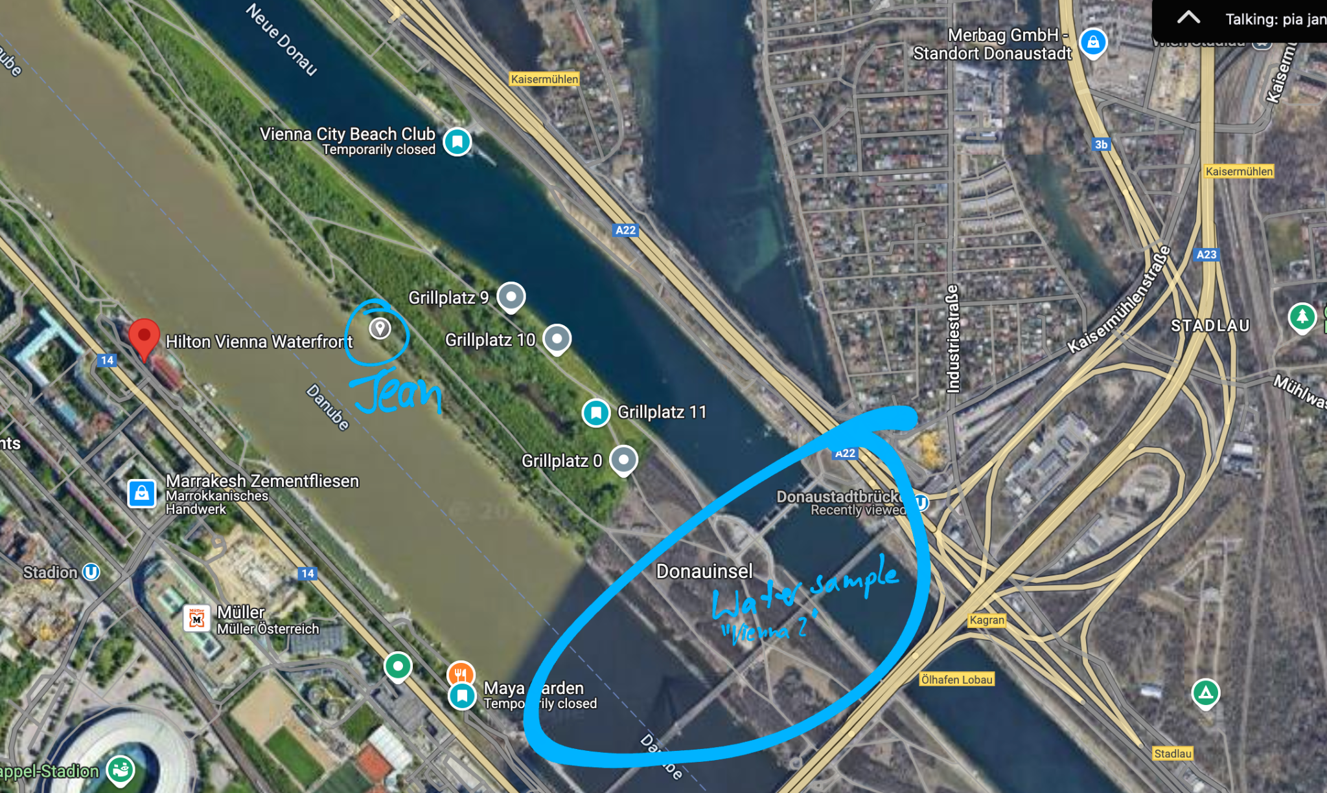
Field recordings (Jean)
Copyright: Jean Beers 2024
2 September 2024, 14:00-18:00
Location-place polluted:
skin rash after swimming
Audible pollution? Audio data reveals ship traffic
Jean went swimming during field recording and recorded while standing in the river
Next day: her skin appeared affected
Audios captured noise pollution that can be linked to water pollution
Water analysis was not done at this exact location but further up stream, also in a tourism-use area. Water sample “Vienna 2” (Donaustadtbrücke)

Slide 7
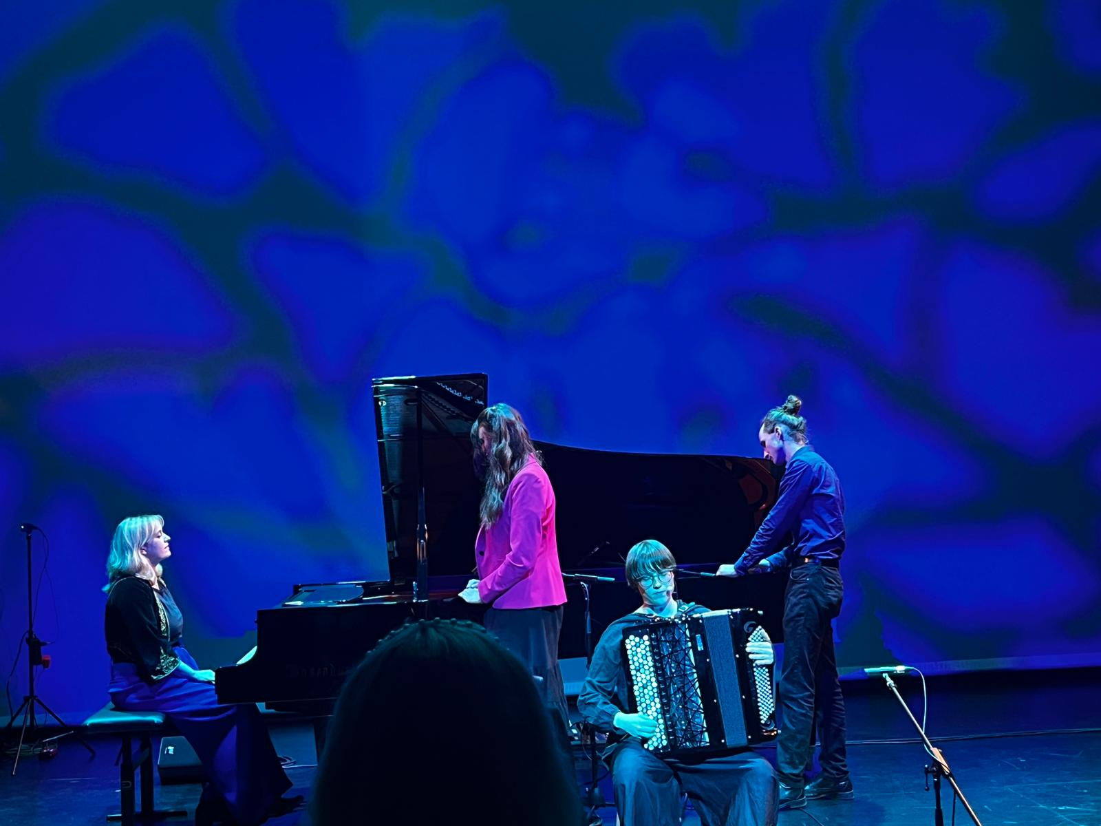
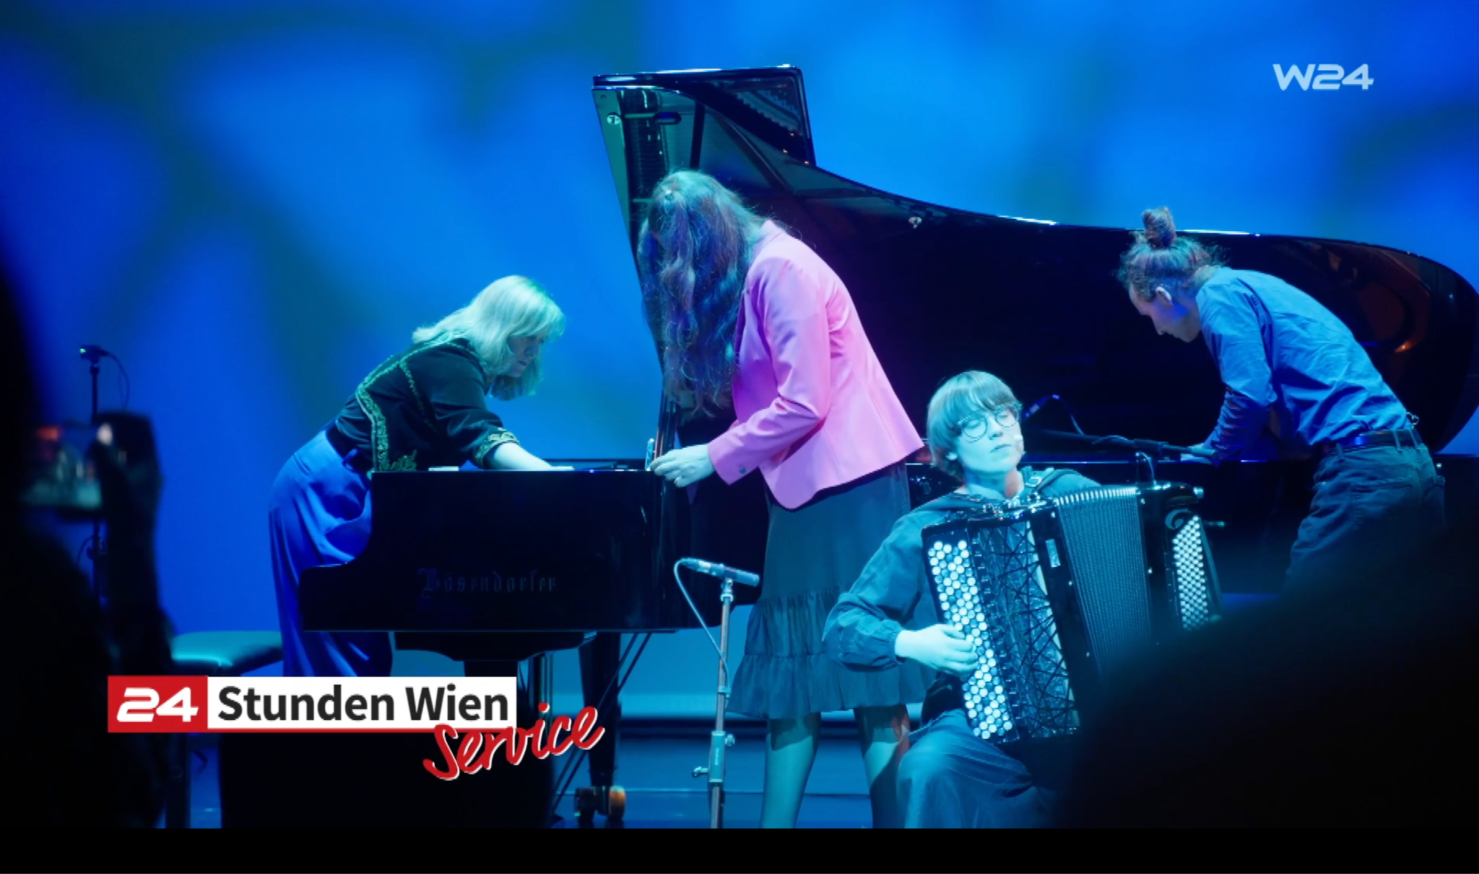
Group improvisation (external ensemble)
Real Ad Lib Mission (ReALM) Ensemble
Copyright: Jean Beers 2024
in concert
19 September 2024, 19:30
MuTH Konzertsaal der Wiener Sängerknaben (Vienna)
Premiere of Hearing Inside Nature
(electronic tape composition by Jean Beers, Sept. 2024)
TV report about the concert
https://vimeo.com/1017920646
https://www.jeanbeers.com/realm

Slide 8
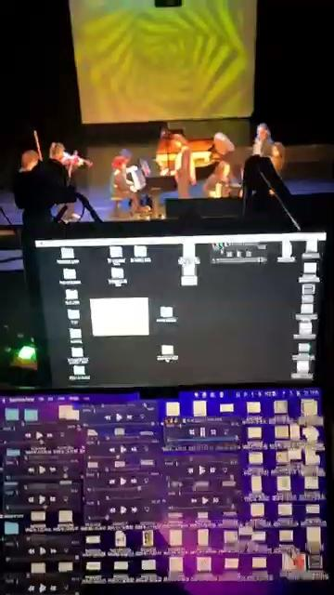
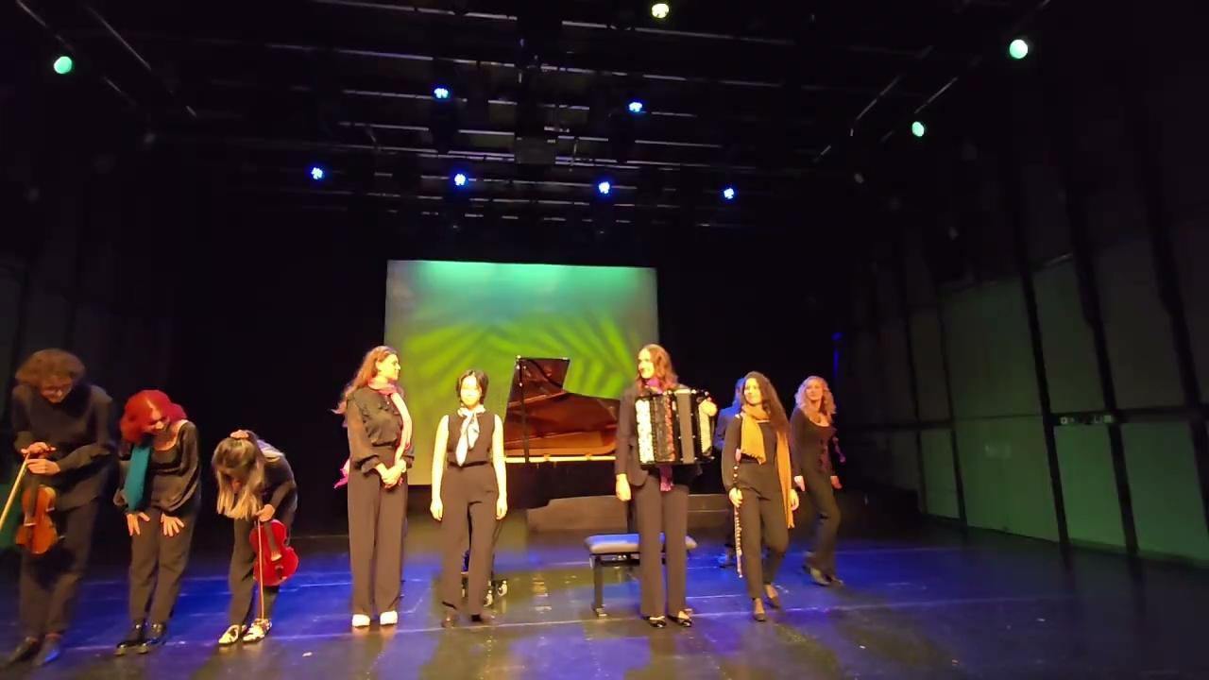
Group improvisation (student ensemble)
At MUK university Ensemble Improvisation Experimentell
Copyright: Jean Beers 2024
in concert
12 November 2024, 17:30, MUK.theater (Vienna)
Concert at Dritte Wiener Ernsthaftigkeit Festival 2024
<-- Click pictures to see →
videos in new window
Live audio-improvisation (laptop) by Jean Beers with instrumental ensemble improvisation (student ensemble)
(electronic tape soundscapes and raw audio data by Fernando Palacios Mateos, 2.9.2024 and composition Hearing inside nature and wind sounds from accordion audios by Jean Beers, Sept. 2024)
https://www.jeanbeers.com/ensembleimprovisationexperimentell

Slide 9
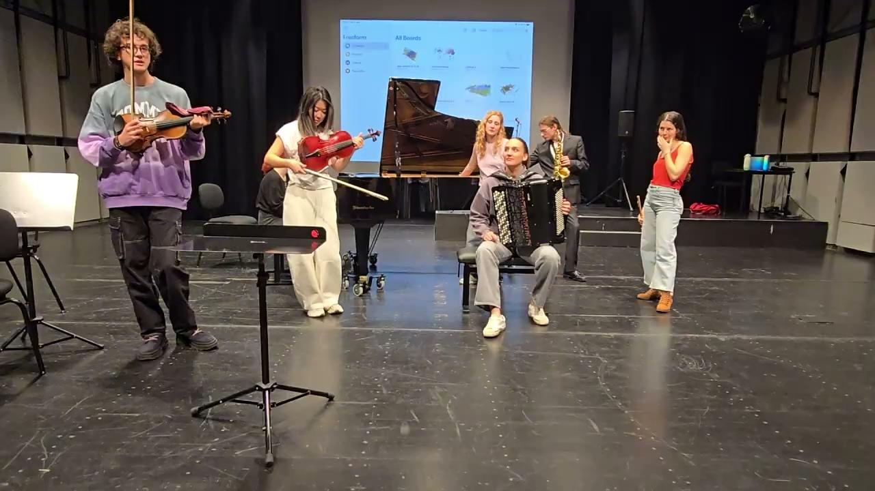

Group improvisation (student ensemble)
At MUK university Ensemble Improvisation Experimentell
Copyright: Jean Beers 2024
in class
October-November 2024, 17:30, classes at university (MUK Vienna)
Audio below
in class – first time experimenting with “Hearing inside nature” + Fernando’s raw audio files (underwater microphones).
This is a rough recording of working with students on our intuitive musical reaction to the sounds.
Video: Rehearsal with students
in muk.theater
Live audio-improvisation (laptop) by Jean Beers with instrumental ensemble improvisation (student ensemble)
(electronic tape soundscapes and raw audio data by Fernando Palacios Mateos (2024) – intuition practice: spontaneous experiments with the river Danube audio files.
https://www.jeanbeers.com/ensembleimprovisationexperimentell

Slide 10
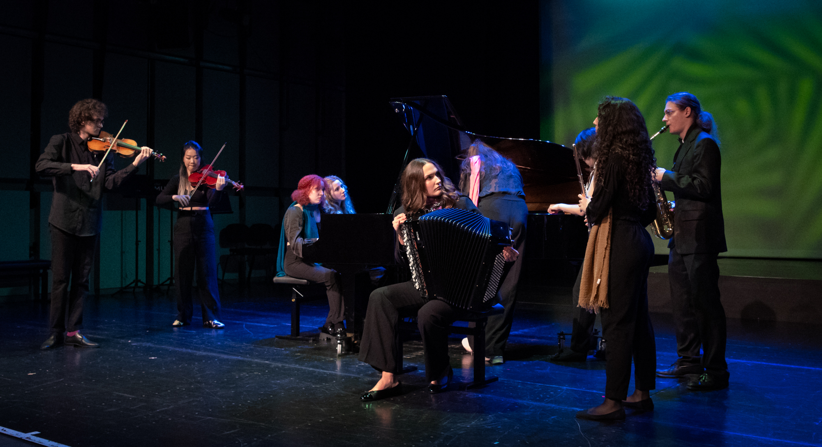
Results, insights
Copyright: Jean Beers 2024
improvisation
Can creative responses to natural surroundings help to identify if pollution levels can be “heard” or sensed?
Group improvisation
(student ensemble and external ReALM Ensemble)
Yes, comparative results from audio data and water analyses suggests that pollution levels in the water can be linked to auditive environmental information, which may be perceived as sonic disturbances, “stressful” or “tense” moments of sound by musicians. The ensemble musicians tended to respond to mechanical sounds (i.e. ships passing or trash in the waterbed) with more tense and stress-inducing musical material. This suggests a direct link between pollution levels, corresponding auditive information from the environment and human emotive responses (stress, anxiety, emotional turmoil).

Slide 11
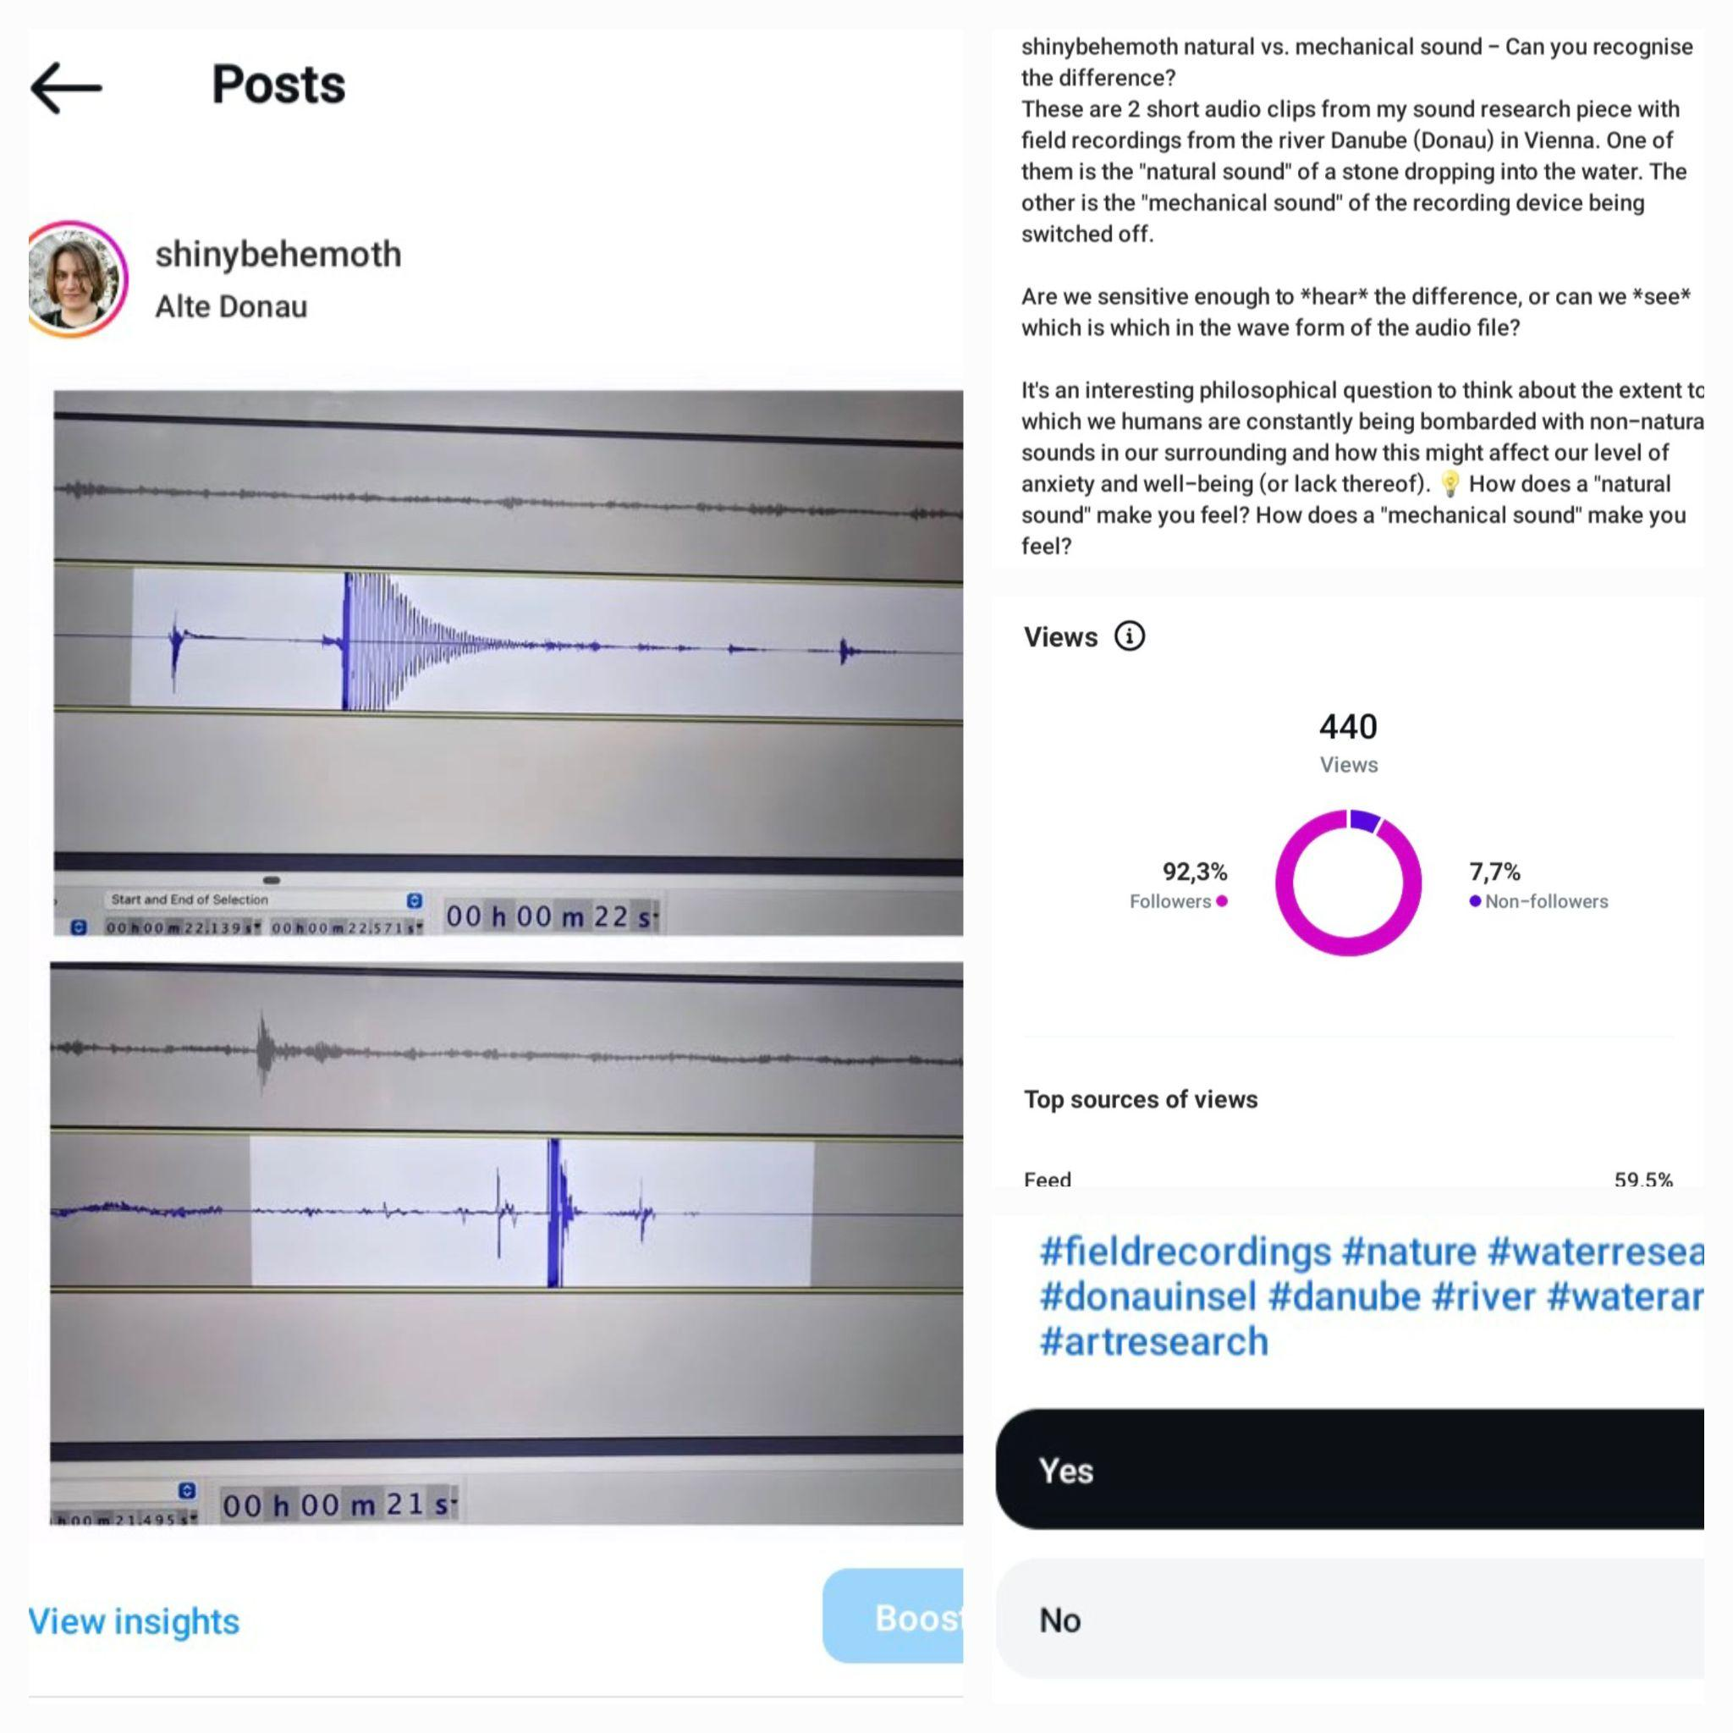
Results, insights
Copyright: Jean Beers 2024
composition
Can creative responses to natural surroundings help to identify if pollution levels can be “heard” or sensed?
Composition (electronic tape) by Jean Beers with soundscapes by Fernando Palacios Mateos
Similarly, the harsh sounds of of mechanical and non-organic sound sources prompted moments of musical drama, symbolising perception of anxiety or disturbance. While working with Fernando’s soundscapes and raw data files, I made an experiment to compare the visual sound waves of two short sounds: one mechanical sound and one natural sound of a water drop (plop). I shared these two sound waves with and without audio on social media, asking the question whether the difference could be seen and heard. All responses noted the difference between the two sounds clearly and realised which was which. This suggests a deep psychological link to humans’ perception of sound and emotive responses. In a word of AI engineering, this clear link between perception of a natural or organic sound source and a reduction in anxiety-response, seems relevant for further investigation.

Slide 12
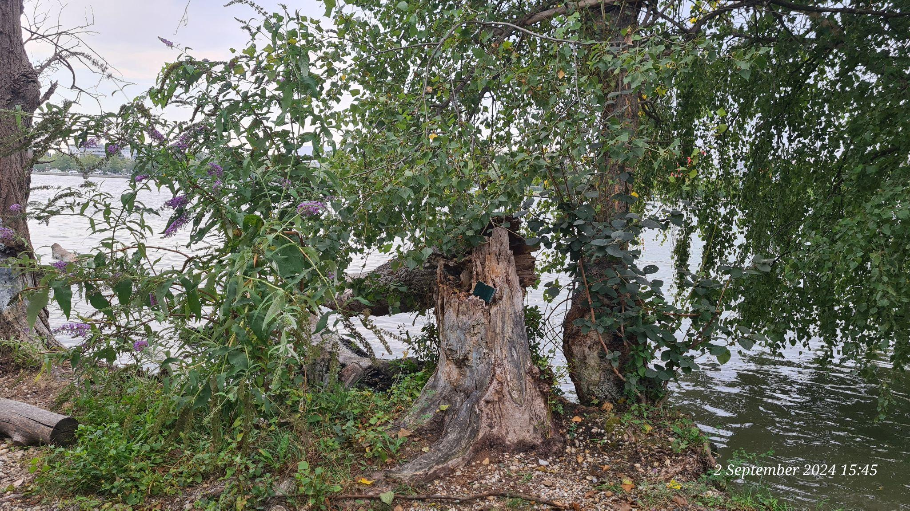

Copyright: Jean Beers 2024

Slide 13
Copyright: Jean Beers 2024

Slide 14
Thank You!
Copyright: Jean Beers 2024
Thank you for the interesting collaboration,
Vilmaurora Castillo
and
Fernando Palacios Mateos
Jean Beers – artistic researcher
www.jeanbeers.com
@shinybehemoth

